Slide 1
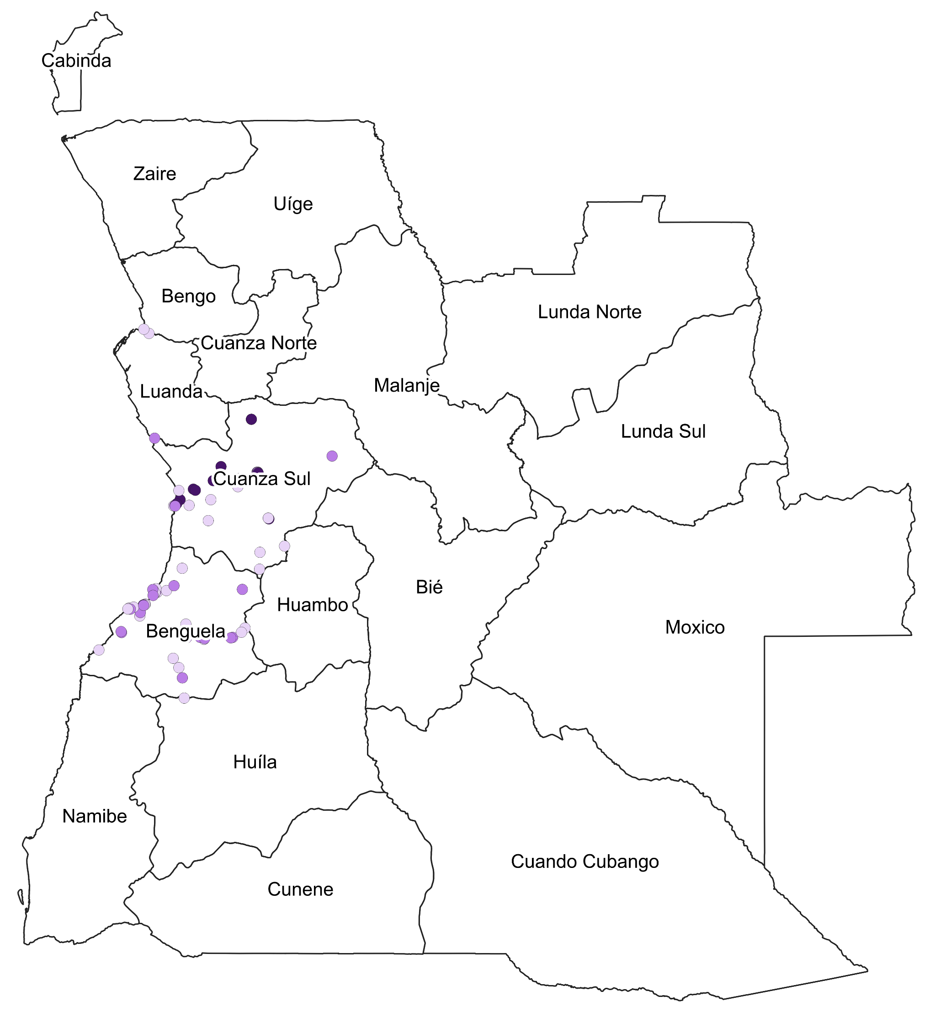



Facility demographics and service availability mapping
Supply Chain and Health Services Dashboard
Distribution of services provided in sampled facilities by location and facility type, %
Map of Angola showing geographical spread of sampled facilities
Facility location
HIV
TB
Malaria
ANC
Immu.
Health care facilities in
rural areas
N/A
Health care facilities in
peri-urban areas
Health care facilities in
urban areas
Facility type
HIV
TB
Malaria
ANC
Immu.
Primary health care
facilities
N/A
Secondary health care facilities
Tertiary health care
facilities

Slide 2
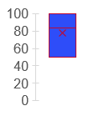
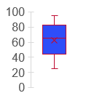
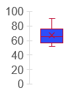
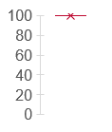
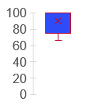
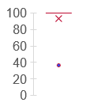
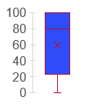
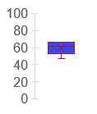
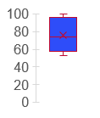
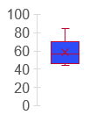
Country level scores for the 11 tHFA indicators (Model 3)
Supply Chain and Health Services Dashboard
High Quality Services
Integrated Supp. Supervision
Integrated HTM for ANC patients
System Readiness for CHWs
58
87
63
60
Facility Composite Score
CHW paid on time and in full
Community Led Monitoring
Availability of Guidelines
70
57
79
100
Oxygen Therapy
Appropriate Testing
Staff Role Recruitment
High facility averages for guidelines, supportive supervision, availability of O2 and community led monitoring
Average means for xx, yy, zzz however these had a wide spread with highs of 90 an lows of 20 and below observed
97
85
70

Slide 3
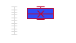

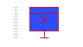

Country level scores for the 11 tHFA indicators (Model 3)
Supply Chain and Health Services Dashboard
Scores of the 11 tHFA indicators
T- scores to be calculated as included in the callout box
High facility averages for guidelines, supportive supervision, availability of O2 and community led monitoring
Average means for xx, yy, zzz however these had a wide spread with highs of 90 an lows of 20 and below observed

Slide 4
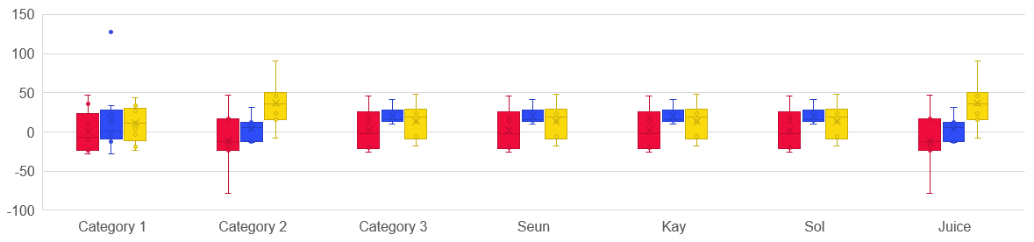
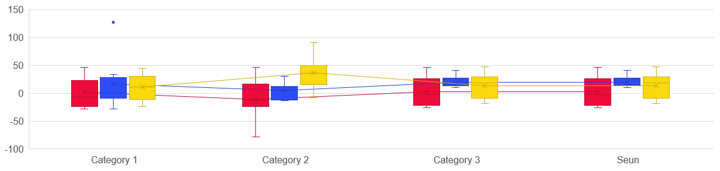
Distibrution of tHFA indicators by facility type
T- scores to be calculated as included in the callout box
To be replaced by simple

Slide 5
KPI 1 : Provision of integrated, people-centered, high-quality services
Supply Chain and Health Services Dashboard
Country Average for Indicator and Primary Dimensions
Average by facility types
Primary health care
facilities
Secondary health care facilities
85
Tertiary health care
facilities
Full indicator
85
85
Add chart to show all indicator scores on this page
People-centeredness
Health worker competence

